Slide 1

Figure 20.9 Maximum transfer unit (MTU)
20.<number>

Slide 2

Table 20.5 MTUs for some networks
20.<number>

Slide 3

Figure 20.10 Flags used in fragmentation
20.<number>

Slide 4

Figure 20.11 Fragmentation example
20.<number>

Slide 5

Figure 20.12 Detailed fragmentation example
20.<number>

Slide 6
Example 20.5
A packet has arrived with an M bit value of 0. Is this the first fragment, the last fragment, or a middle fragment? Do we know if the packet was fragmented?
Solution
If the M bit is 0, it means that there are no more fragments; the fragment is the last one. However, we cannot say if the original packet was fragmented or not. A non-fragmented packet is considered the last fragment.
20.<number>

Slide 7
Example 20.6
A packet has arrived with an M bit value of 1. Is this the first fragment, the last fragment, or a middle fragment? Do we know if the packet was fragmented?
Solution
If the M bit is 1, it means that there is at least one more fragment. This fragment can be the first one or a middle one, but not the last one. We don’t know if it is the first one or a middle one; we need more information (the value of the fragmentation offset).
20.<number>

Slide 8
Example 20.7
A packet has arrived with an M bit value of 1 and a fragmentation offset value of 0. Is this the first fragment, the last fragment, or a middle fragment?
Solution
Because the M bit is 1, it is either the first fragment or a middle one. Because the offset value is 0, it is the first fragment.
20.<number>

Slide 9
Example 20.8
A packet has arrived in which the offset value is 100. What is the number of the first byte? Do we know the number of the last byte?
Solution
To find the number of the first byte, we multiply the offset value by 8. This means that the first byte number is 800. We cannot determine the number of the last byte unless we know the length.
20.<number>

Slide 10
Example 20.9
A packet has arrived in which the offset value is 100, the value of HLEN is 5, and the value of the total length field is 100. What are the numbers of the first byte and the last byte?
Solution
The first byte number is 100 × 8 = 800. The total length is 100 bytes, and the header length is 20 bytes (5 × 4), which means that there are 80 bytes in this datagram. If the first byte number is 800, the last byte number must be 879.
20.<number>

Slide 11
Example 20.10
Figure 20.13 shows an example of a checksum calculation for an IPv4 header without options. The header is divided into 16-bit sections. All the sections are added and the sum is complemented. The result is inserted in the checksum field.
20.<number>

Slide 12
An IP router with a Maximum Transmission Unit (MTU) of 200 bytes has received an IP packet of size 520 bytes with an IP header of length 20 bytes. The values of the relevant fields in the IP header.
20.<number>

Slide 13
Since MTU is 200 bytes and 20 bytes is header size so,
The maximum length of data = 180 bytes but it can’t be represented in fragment offset since it is not divisible by 8 so, the maximum length of data feasible = 176 bytes.
Number of fragments = (520/200) = 3.
Header length = 5 (since scaling factor is 4 therefore, 20/4 = 5)
Efficiency, e = (Data without header)/(Data with header) = 500/560 = 89.2 %
20.<number>

Slide 14
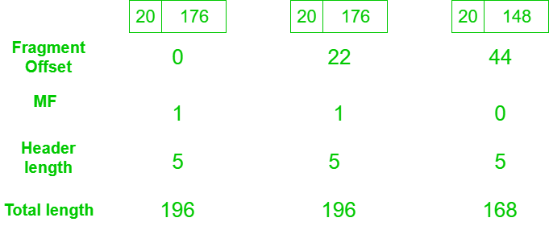
20.<number>

